Slide 1
Instacart Market Basket Analysis
Stephen Parvaresh

Slide 2
Preliminary EDA
First I looked at the dataframes and found that days_since_prior_orders had a plethora of zeros, probably because those instances were first-time orders. To mitigate this, I found the maximum days since prior orders (30) and filled all the nans with 31, because I was only interested in the data month-to-month.
This was the only data cleaning that needed to be done.

Slide 3
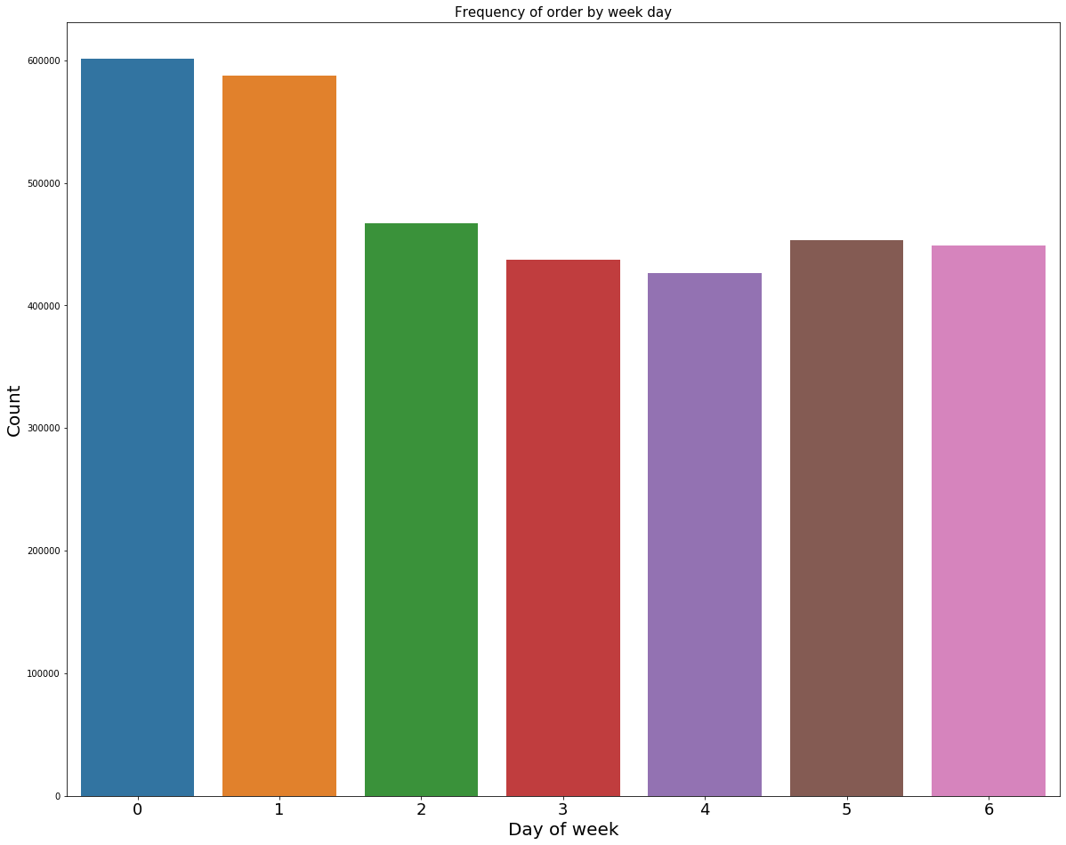
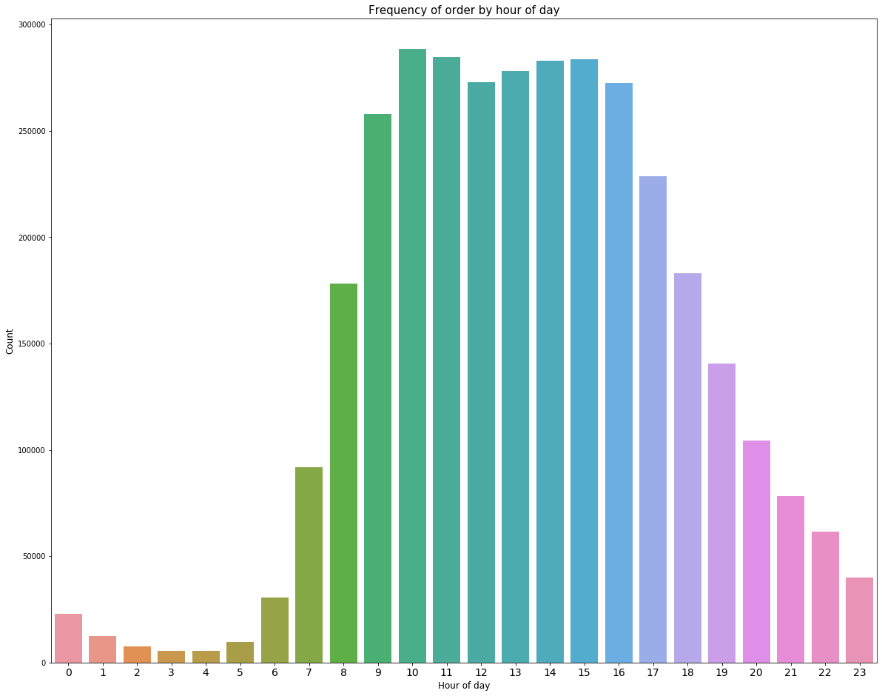
Preliminary EDA Cont.
First, I looked at the effect of day of the week, and time of the week has on when people ordered.
We can see that Saturday and Sunday are the most popular days to order, and most shopping happens between 7am and 8pm.

Slide 4
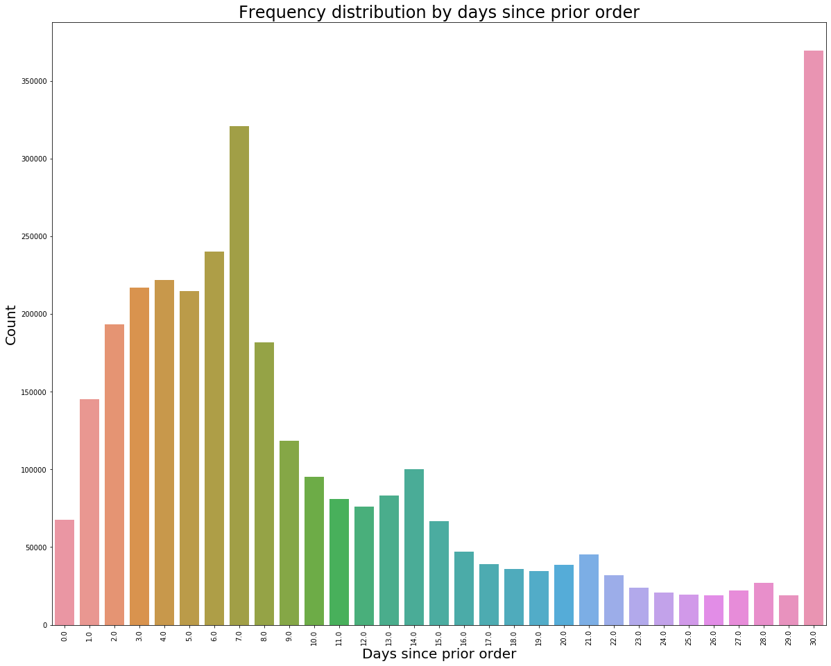
Preliminary EDA Cont.
We can see that based on the days since prior orders that most people ordered either once per week or once per month,
with peaks at 14 and 21.

Slide 5
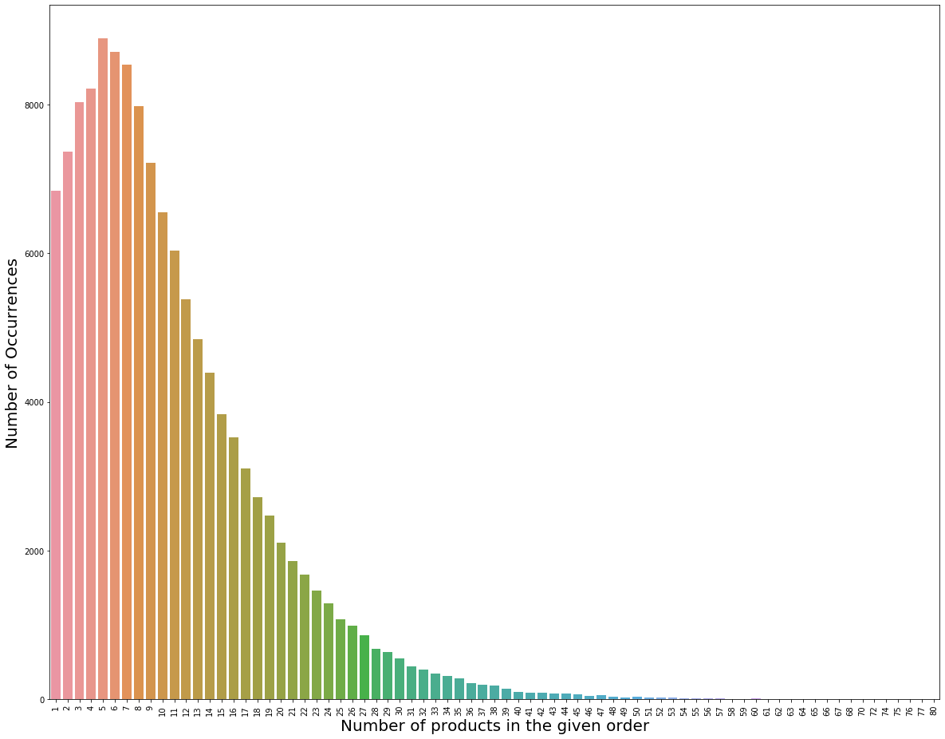
Preliminary EDA Cont.
Next, by taking the ratio between ordered and reordered, we can see that 59% of products are reordered.
And we can see that most orders contained
5 products. This was done by
grouping the maximum add_to_cart_order
by order_id, with the counts being the
Add_to_cart_order value counts.

Slide 6
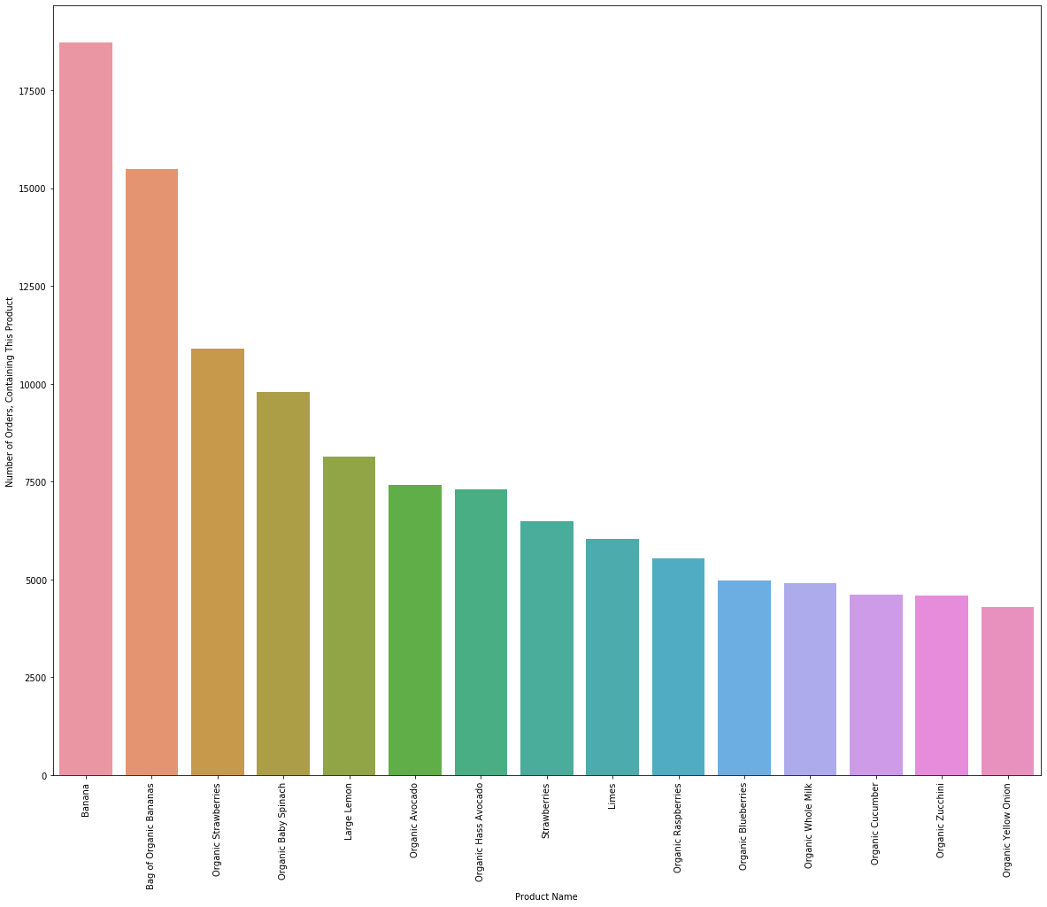
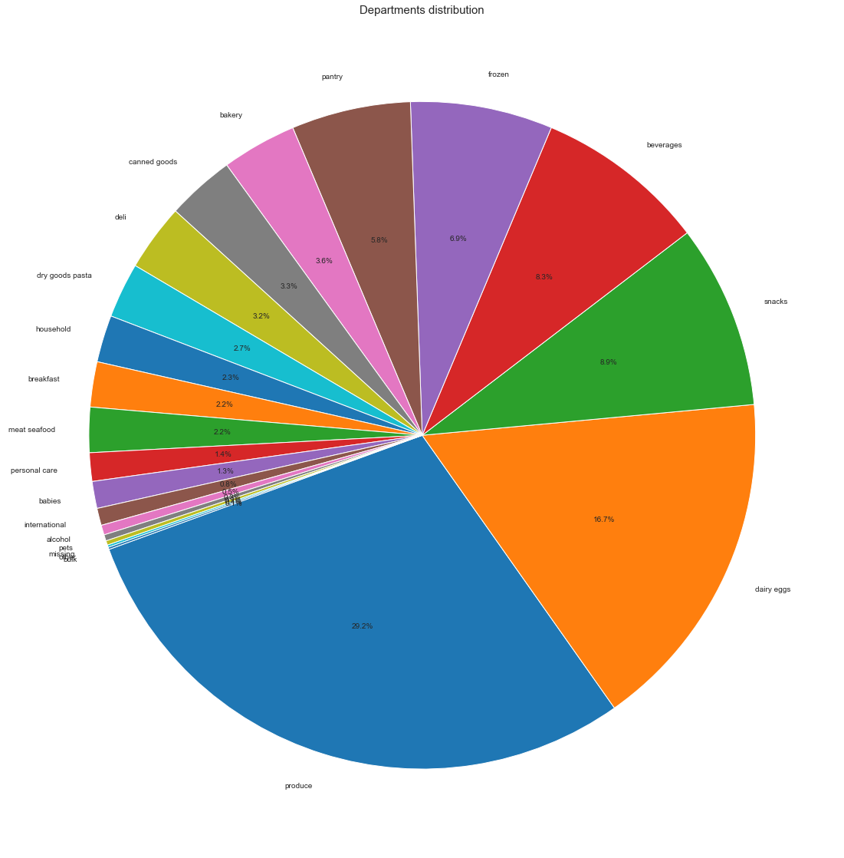
Preliminary EDA Cont.
The most popular products were produce, 6 of the top 10 being organic. For this, I grouped order_id by product_id and found the value counts of product_id.
Further, produce is the most shopped department, followed by dairy and eggs.

Slide 7
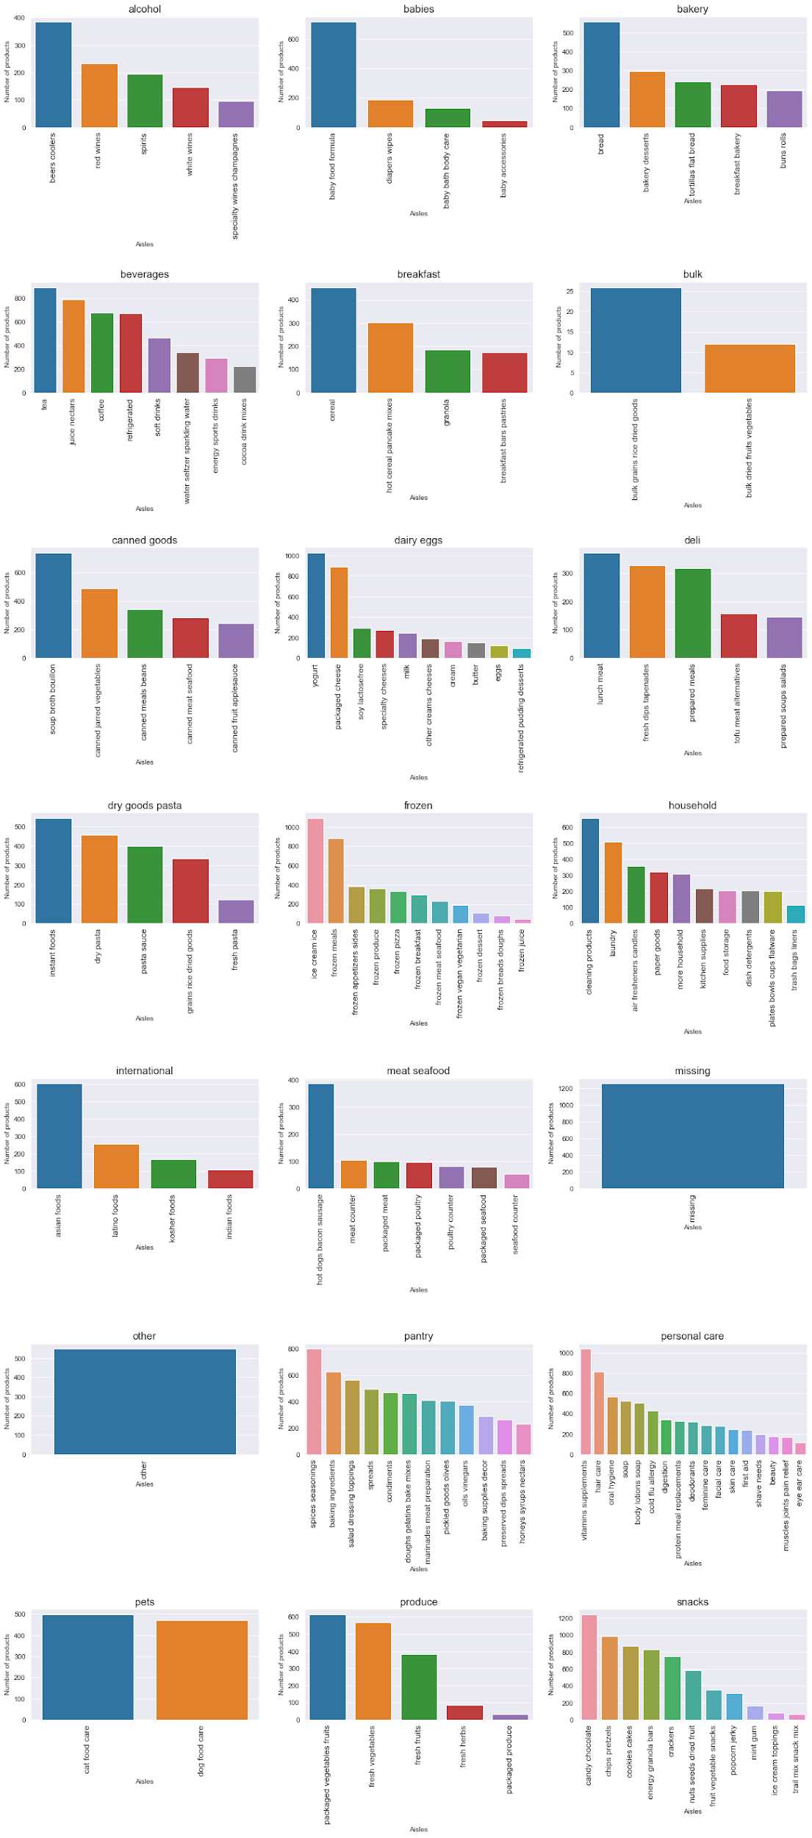
Preliminary EDA Cont.
This set of graphs shows the most important aisles in each
department.
These were created by merging the products and
departments dataframes and grouping department and aisle
by product ID, and finding the total number of products.

Slide 8
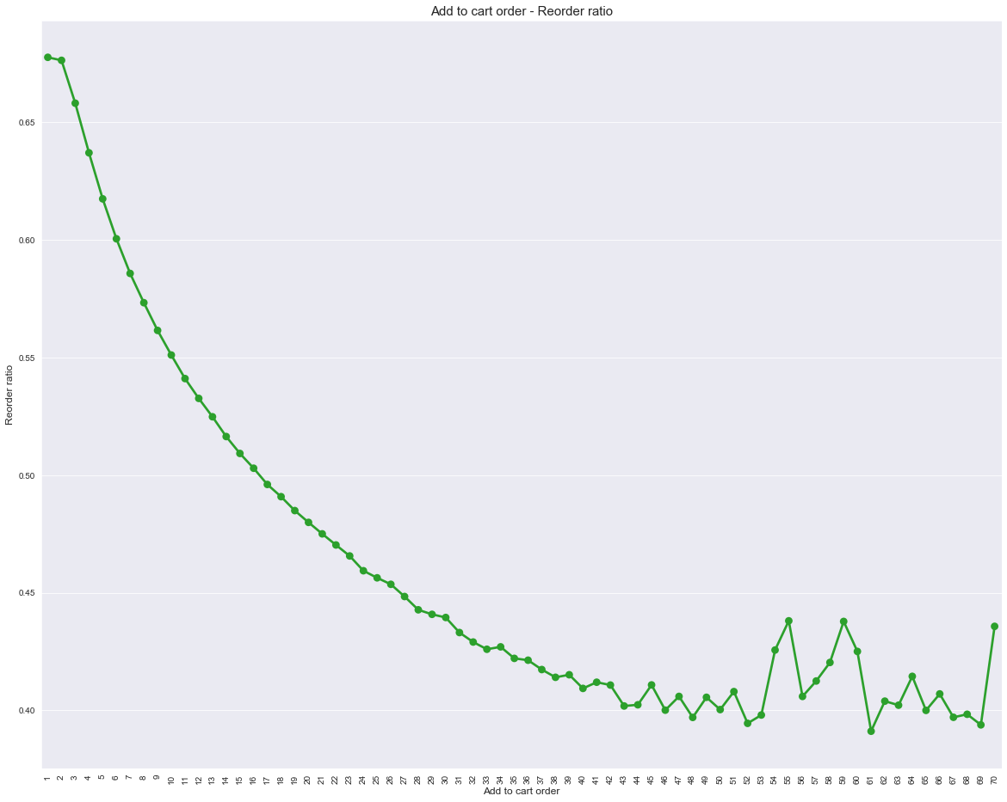
Preliminary EDA Cont.
This shows the ratio between the order
products were added to the cart and
the amount they were reordered.
It’s visible that items that were added
first (produce) were the most often
reordered.
For this I found the ratio between
the add_to_cart_order and reordered
of products.

Slide 9
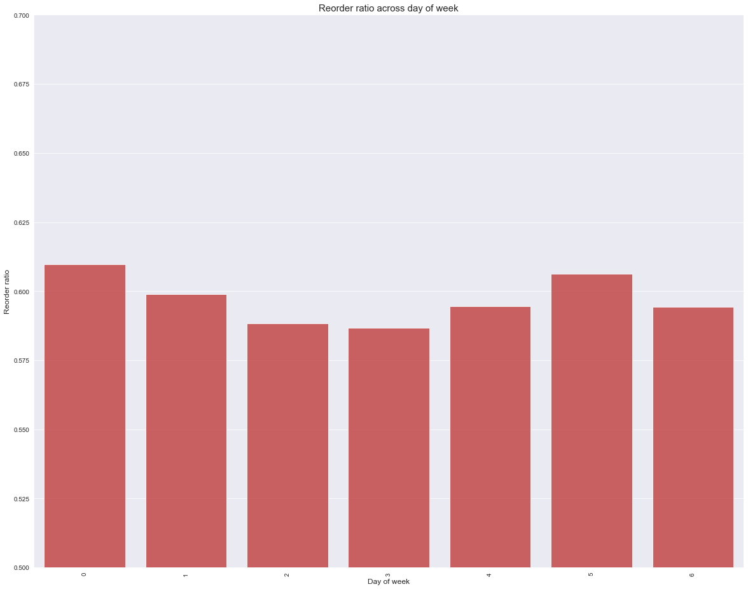
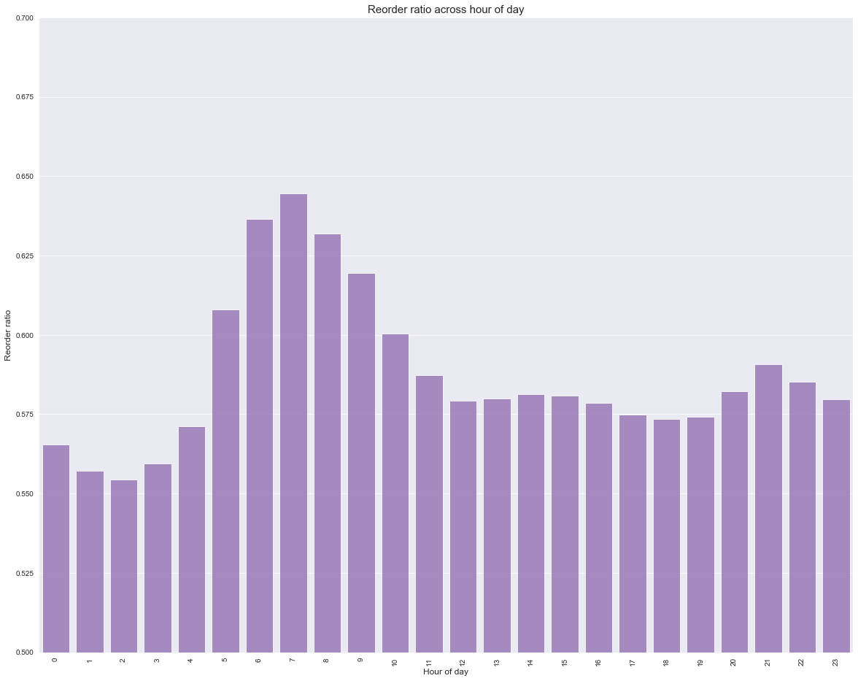
Preliminary EDA Cont.
These graphs show the day of the week and hour
of the day products were reordered.
Saturday and Thursday are the most commonly
reordered days, and the morning are the most
commonly reordered hours.

Slide 10
KNN To Determine Product Reorder
I used KNN to determine if a product is reordered. I used the KNN model because it is a simple, supervised learning algorithm that relies on labeled input data to learn a function that produces an appropriate output when given new unlabeled data.
I ran a for loop that would run all n values between 1 and 30 to find the best value.
Selecting all columns gave the best results, but the highest accuracy score for determining if a product was reordered at all by all users was 0.560 with an n value of 29 , which is not very good.
I could have run for higher n values, but the graph showed a gradual plateauing, so I was not going to do better than 0.57 at most.

Slide 11
Random Forest Model to Determine if a Product is Reordered
I decided to use a Random Forest model to predict an individual’s likeliness to reorder a product because Random Forests use Decision Trees, Bagging, and Bootstrapping to split the data into smaller data groups based on the features of the data until we have a small enough set of data that only has data points under one label.
Random Forests are great with highly dimensional data, make quick predictions, and robust with non-linear data, and have low bias.
The Random Forest Model I created, I used a random sample of 1% of the data due to computing limitations.
I then trained my model using all numerical columns, with my y-value being products reordered. I used an n_estimators value of 500, which I felt would be a robust enough number of trees in the forest, but small enough to run on my machine.
Using the BaggingRegression, my best accuracy for determining if a product was reordered was 42.5%.

Slide 12
Random Forest Model Based on Other Analysis
Next, I found a Kaggle competition submission and used their model, with a few modifications, to see if I could get a better accuracy on my previous scores.
First, I created DataFrames that ‘flattened’ the time series data to use less processing power. This recommendation came from my coworkers, and I don’t understand processing enough to know why this works. I changed the train data variables from the ones that the original Kaggle participant used, and changed some of the groupings (i.e. I grouped the order ID by user ID to determine the number of priors by each customer. This helped in the model by narrowing each user to their orders. I also grouped maximum cart size by order IDs to determine the number of products each order had, which would help determine if product was dependent on the size of the cart.)

Slide 13
Random Forest Model Based on Other Analysis Cont.
I then determined the best probability threshold to use, 0.6, using ClassifierPropThresholds from sklearn.
I then used that probability threshold and loaded the Random Forest model fitted on all the training data to evaluate the F1-measure performance on the validation set.

Slide 14
Results
From my rudimentary Random Forest model, I obtained an accuracy of 42.4% predicting whether a product would be reordered based on previous orders.
From the other model found on Kaggle, the best mean F1-score achieved using the fitted random forest model was 36.2%, which isn’t great, but this was a very simply model.
So, this model can predict the probability of a product being reordered by a customer 36.2% of the time. Further tweaking could be used to better fit the data, grouping different variables together to get better results.

